Slide 1
A Project on Blood Bank Management System
By
Rubaiyat Tasnia Husain
Under the Supervision of
Dr. Ashraf Ali
Associate Professor
Dept. of SWE

Slide 2
Blood Bank
A blood bank is a center where blood gathered as a result of blood donation, stored and preserved for later use in blood transfusion. The term "blood bank" typically refers to a division of a hospital where the storage of blood product occurs and where proper testing is performed (to reduce the risk of transfusion related adverse events). However, it sometimes refers to a collection center, and indeed some hospitals also perform collection.

Slide 3
What is a Blood Bank Management System?
A blood bank management system is a framework about blood donation & information of donors. It is made to organize the database of donor according to blood type. As the availability of blood or finding a donor on emergency purpose should be easier.

Slide 4
Aspect behind this Project
Difficulty to find a donor
Difficulty of finding a Donor of desired Blood group
Time & place adjusting problem
Facing problem while communicating the donor

Slide 5
Outline of the Project
Admin :
Add Donor
View Donor list
Delete Donor
Guest :
View Donor list

Slide 6
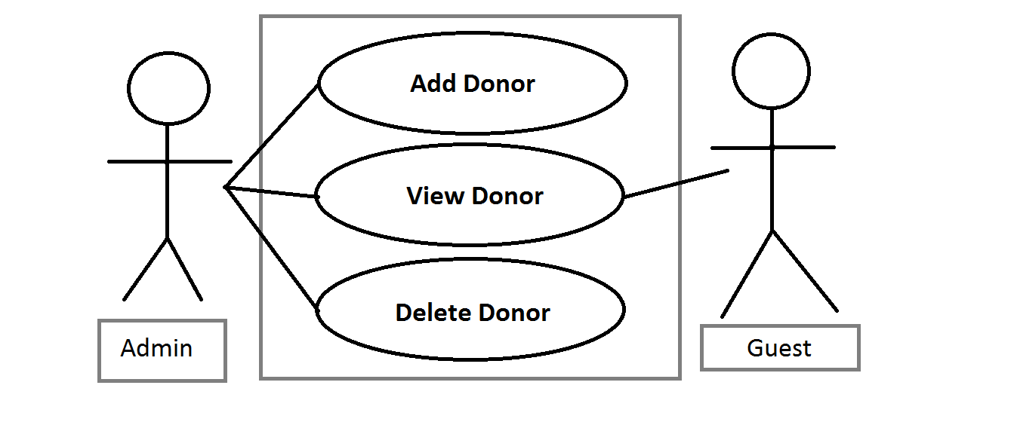
Use-Case Diagram

Slide 7
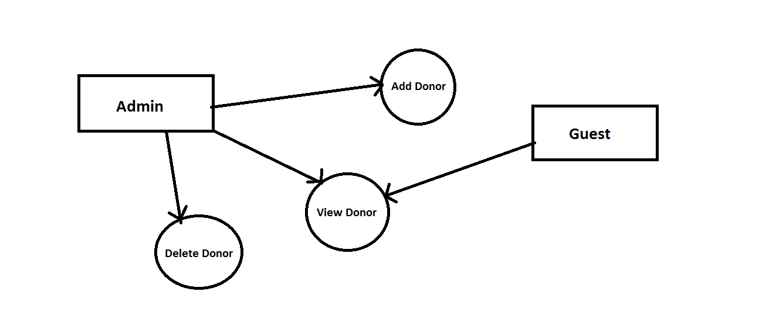
Data Flow Diagram

Slide 8
Functional requirements
Select blood group & find a donor
Display donor list
Contact Information & Address of the donor

Slide 9
Non- functional requirements
Fast
User friendly
Easy language
No need of Training

Slide 10
Software requirement
OS > Windows, Linux, Mac
Compiler > Any C language supported compiler

Slide 11
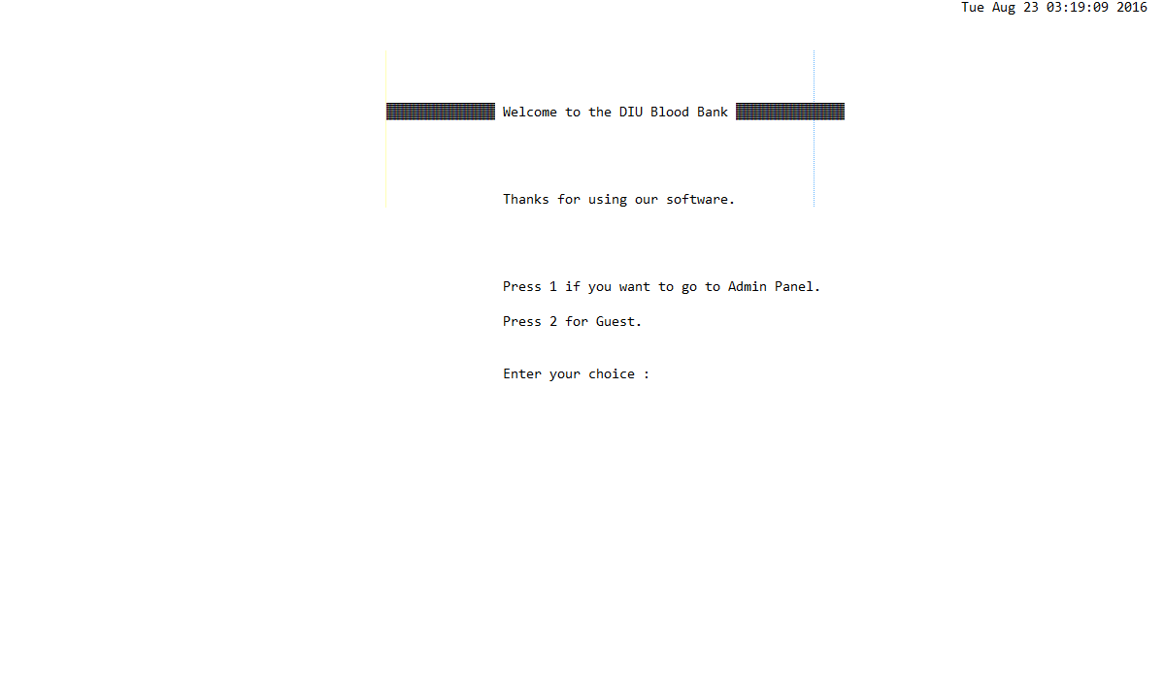
ScreenShots of the Project

Slide 12
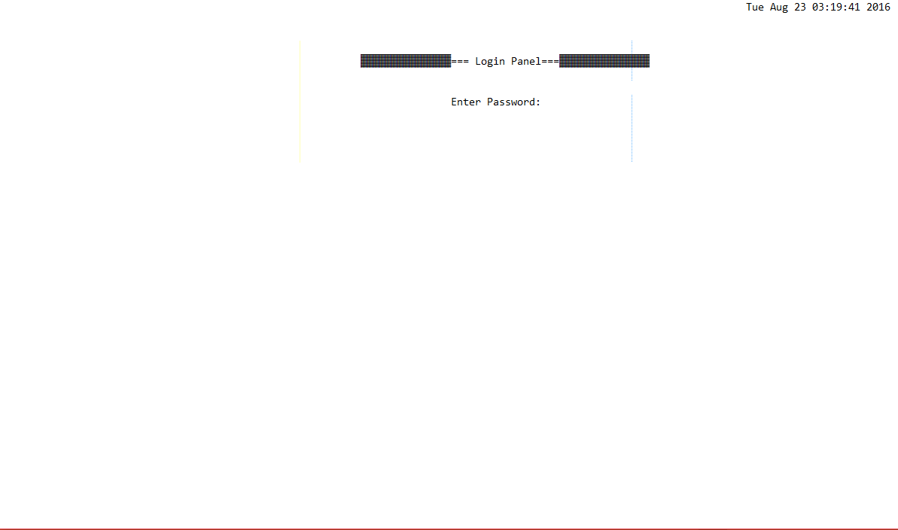

Slide 13
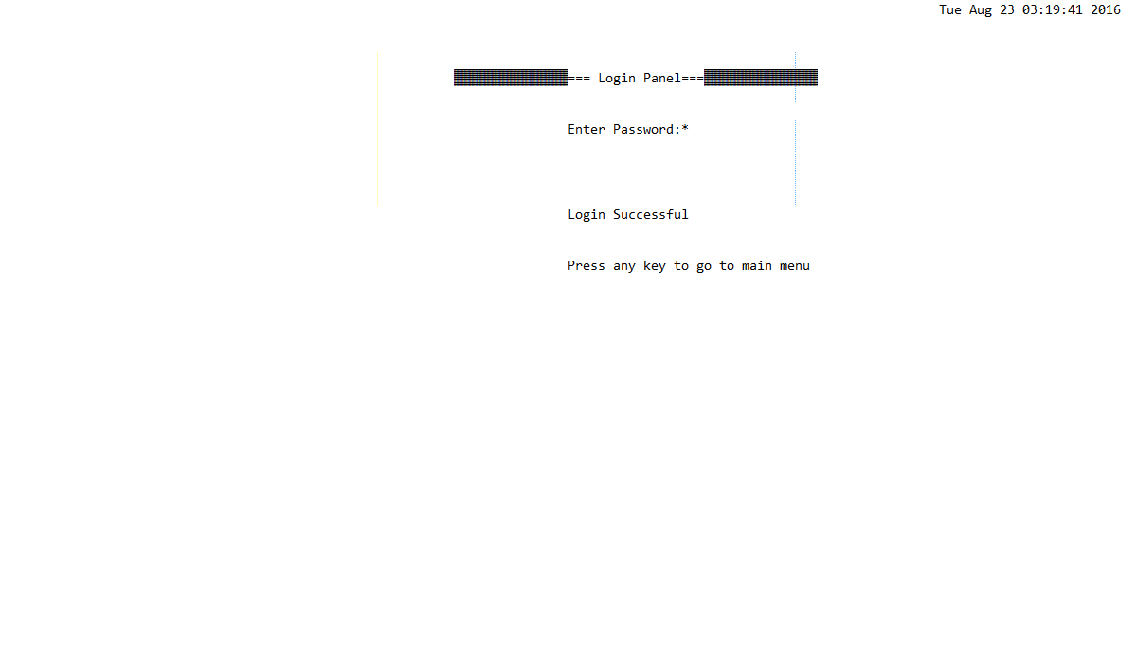

Slide 14
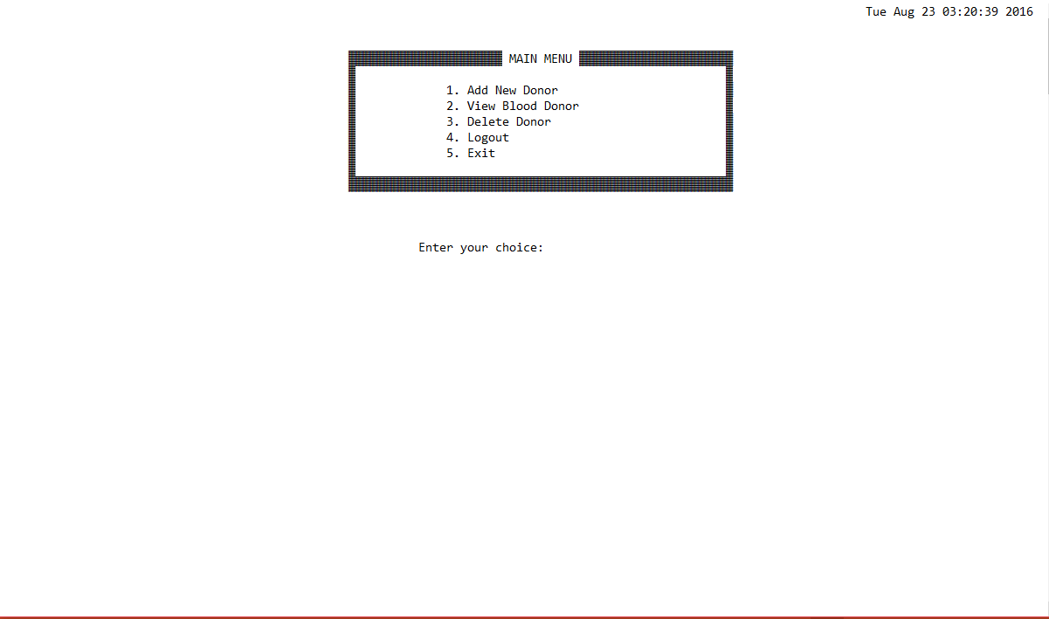

Slide 15
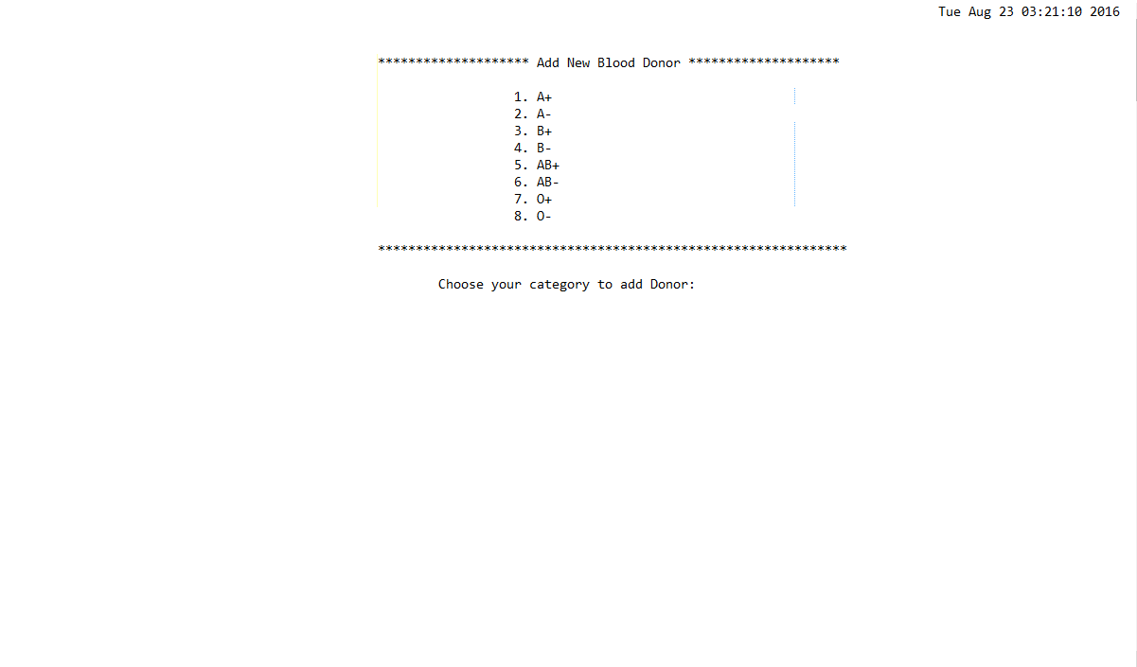

Slide 16
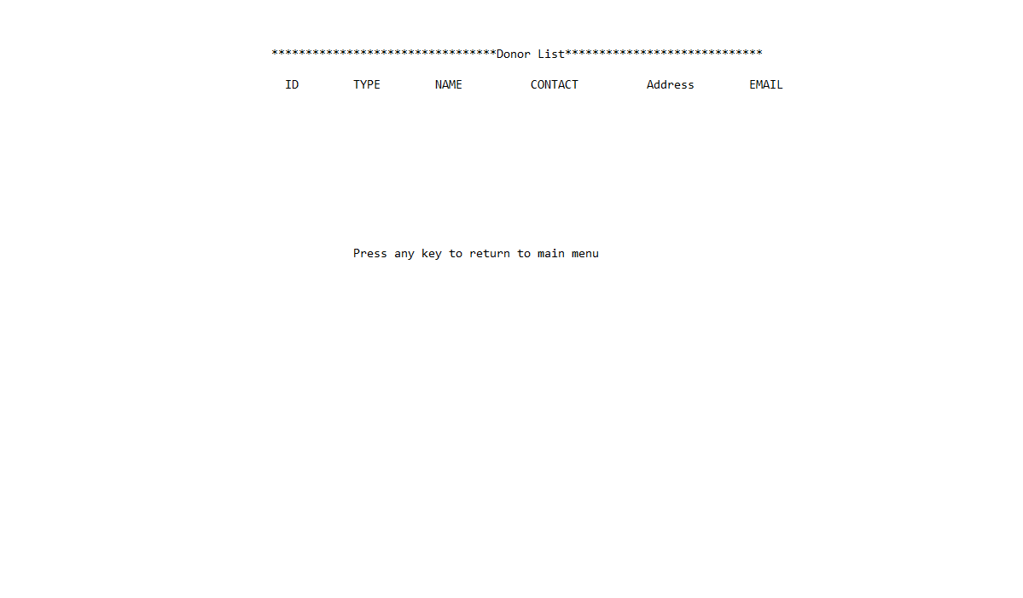

Slide 17
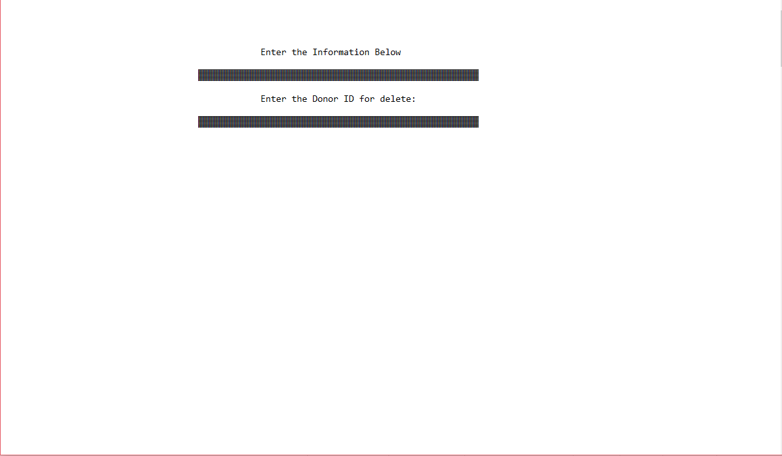

Slide 18
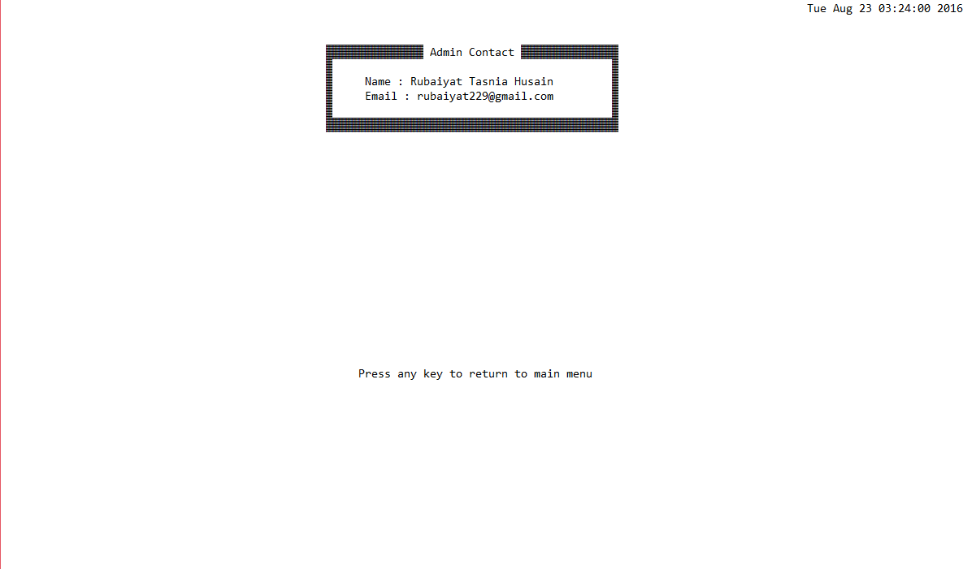

Slide 19
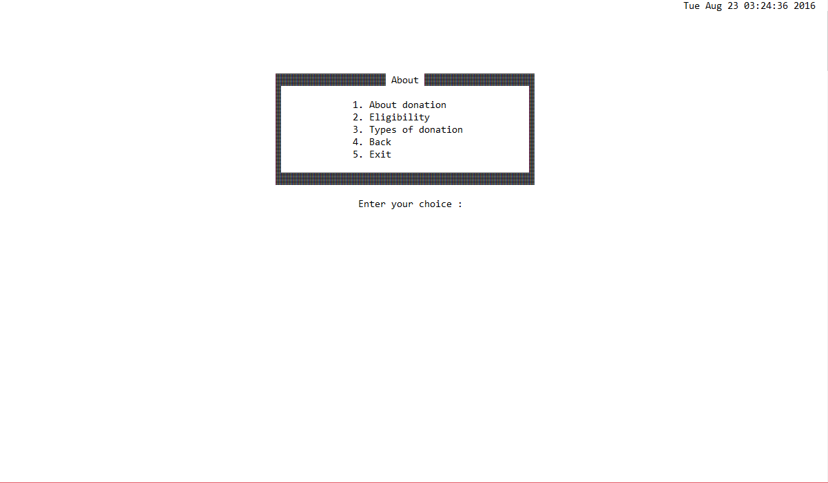

Slide 21
Management of change
can be changed the options & features by the admin
if updated, user can input information
in larger scales donor adding option will be added
if needed, donated patients information will be added

Slide 22
Upcoming Features
date of last donation can be added.
As a donor can’t donate blood 2 times within three months, a feature can be added which will hide the specific donor’s information for next three months.
If updated, user could be able to open an account, to be a voluntary donor.
If a donor is having disease or under medication for which donation will not be possible for a certain time, donor will be able to hide the ID for that time. After the time span is over, account will be unhidden.
There is a plan to make this product for android application in future.

Slide 23
Conclusion
satisfies the requirements
saves time
Will be needed updates in larger system

Slide 24
Any question?

Slide 25
Thank you

